Slide 1
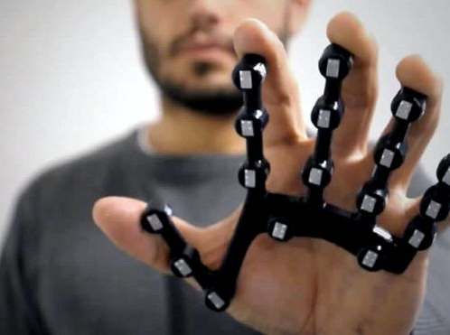
Smart Gloves
A PROJECT BY
TEAM TECHNOCRATS

Slide 2
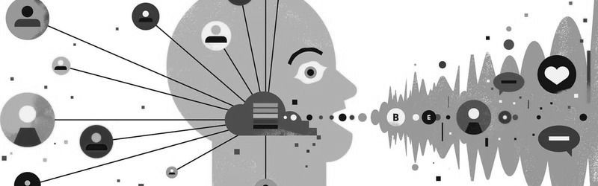
WHAT IS THIS PROJECT FOR?
Many people who are partially paralyzed or unable to speak have become alienated from society as they are unable to communicate with others efficiently as majority of people don’t understand sign language
This project aims to solve the daily challenges faced by the people , who are unable to speak and listen.

Slide 3
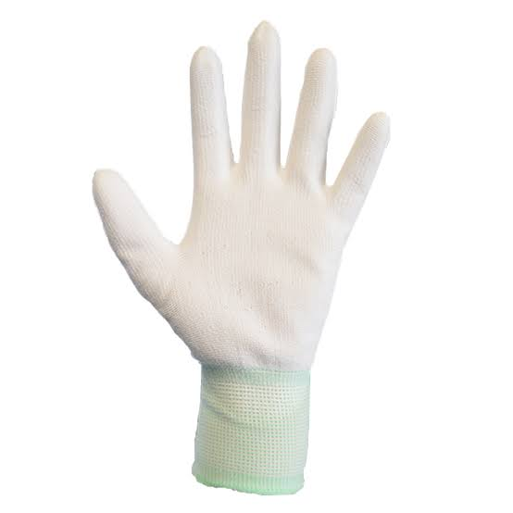
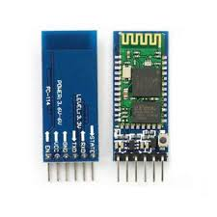
COMPONENTS USED
A GLOVE
ARDINO BOARD
BLUETOOTH MODULE (HC-05)
SMART GLOVE APP
JUMPER WIRE

Slide 4
HOW DEVICE WORKS??
INPUT IS GIVEN BY THE USER VIA SMART GLOVES.
THIS SENDS A HIGH VALUE INTO THE UNO BOARD WHERE THE BLUETOOTH MODULE IS ATTACHED.
THE MODULE THAN SENDS THE INPUT PIN NUMBER TO THE DEVICE TO WHICH IT IS CONNECTED.
NOW THE INSTALLED APP (SMART GLOVE) WILL EXECUTE THE COMMAND WHICH IS WRITTENIN THE CODE.

Slide 5
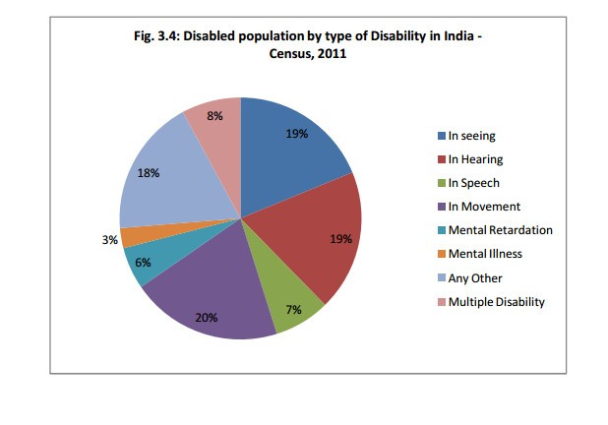
People who need this device:

Slide 6
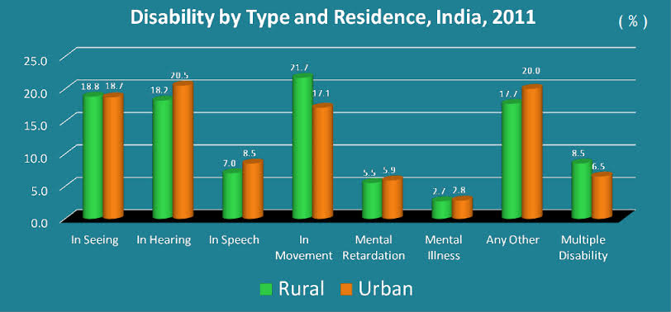

Slide 7
HOW PEOPLE BENEFIT??
With this wearable smart glove , mute people or patient can easily communicate by just tapping the points on the glove by their thumb that results in 4 different commands that are both audible audio and image on any android smartphone via an app.
This can also be used in automation of day to day things like home appliances.

Slide 8
Why this glove??
These wearable gloves are both affordable and feasible.
It is easy to wear and customizable according to one’s need.
Can be used by people of any age group and also illiterate.

Slide 9
Thank you

